Slide 1
AWS Transform
Migration Assessment Business Case
August 2025

Slide 2
Agenda
Executive Summary
Insights
Next Steps
Appendix

Slide 3




Migration Customer Journey
Assess
Mobilize
Migrate & Modernize
Portfolio
Migrate
 |  |  | Migration & modernization experience
Skills/center of excellence | Landing zone | Operating model | Security & compliance
Migrate
Rapid discovery
TCO report
Migration plan
Discovery & planning
Business case
Mig. Evaluator/OLA
Migration Readiness Assessment
Accelerators
Operate & optimize
Briefings & workshops
Modernize
Immersion day
People
Platform
Create a case for change
Build readiness through experiences
Accelerate transformation at scale

Slide 4
Executive Summary

Slide 5
Executive Summary
Scope
Insights
Next Steps
Results based on a scope of 368 servers
Region: US East (N. Virginia)
16 inactive servers removed from scope
Right-sized & optimized models
$119,044 annualized spend on AWS
48% savings compared to On-Demand modeling
Engage a specialist
Perform wave planning using VMWare job

Slide 6
Assessment Scope
Servers
Storage
Databases
Excluded from Assessment
Total servers: 368
Windows Servers in scope: 16
Linux Servers in scope: 352
Provisioned Storage (TiB): 12
Utilized Storage (TiB): 6
SQL Servers: 0
SQL Servers with Enterprise edition: 0
SQL Servers with Standard edition: 0
Inactive servers: 16
Windows desktops: 0

Slide 7
Insights

Slide 8
Financial Overview
 | On-Demand | 1 Year NURI (Shared Tenancy) | 1 Year NURI (Mixed Tenancy) | 3 Year NURI (Shared Tenancy)
Compute | $221,039 | $154,880 | $139,817 | $113,147
Storage | $5,897 | $5,897 | $5,897 | $5,897
Annual total | $226,936 | $160,777 | $145,714 | $119,044
Annual Savings compared to On-Demand | - | 29% | 36% | 48%
Assumptions
AWS Region used for cost modelling: US East (N. Virginia)
Peak CPU Utilization: 25%
Peak Memory Utilization: 60%
SQL Server and Windows Server BYOL eligibility subject to Microsoft licensing terms
Windows Server bring your own licenses (BYOL) only available on dedicated hosts for versions prior to Windows Server 2022
Storage Utilization (if missing data): 50%
Provisioned Storage (if missing data): 500 GiB

Slide 9
Next Steps

Slide 10

Engage a Specialist
Why to engage a migration specialist?
Infrastructure optimization analysis and AWS service selection
License optimization scenarios to maximize cost savings
Deep dive into specific requirements
Develop customized migration roadmap with prescriptive next steps

Slide 11






Wave Planning & Migration using VMWare Job
Transform your VMware environment into a modern, cost-efficient AWS cloud infrastructure while enhancing security and unlocking innovation with AI-powered migration
Discovery and data ingestion
VM
migration and deployment
Wave
planning
Network conversion and migration

Slide 12
Additional Recommendations
AWS Training & Certification
AWS Managed Services (AMS)
Build confidence by validating your cloud expertise with an industry-recognized credential to lead cloud initiatives using AWS.
Optimize your cloud infrastructure and security operations through 24x7 proactive monitoring, incident management, automation, and execution of operational best practices.
Microsoft on AWS Cost Optimization (MACO)
Datacenter Divest
A collection of cost optimization strategies for Microsoft workloads running on AWS services and for tracking cost optimization with AWS tags.
Learn how we can make the transition to AWS as stress free as possible by creating innovative deals for customers through Data Center, Colo, IT and IPv4 Divestiture.

Slide 13
Disclaimer
This report provides an estimate of fees in USD, and savings based on certain information you provide. Fee estimates do not include any taxes that might apply. Your actual fees and savings depend on a variety of factors, including your actual usage of AWS services, which may vary from the estimates provided in this report. Additional configurations are available on request by engaging a specialist.

Slide 14
Thank You!

Slide 15
Appendix

Slide 16
AWS Deployment Summary

Slide 17
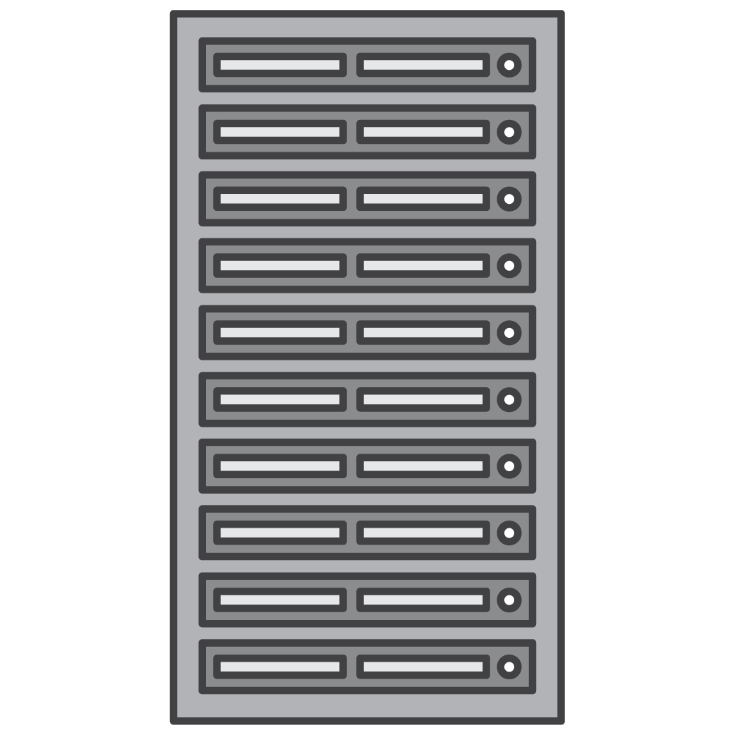
EC2 Instances: Shared Tenancy and Dedicated Hosts
Shared Tenancy
Dedicated Hosts
Customer A
Customer B
Customer C
Customer D
Customer E
Customer E
Customer A
Multi-tenant servers host instances for multiple customers
AWS determines which host instances run on
You pay per-instance
Single-tenant servers host instances dedicated to one AWS customer
Launch instances to same physical server through targeted placement
You pay per-host, per-hour

Slide 18
Distribution of Recommended Instances
Shared Tenancy Blueprint
Mixed Tenancy Blueprint
Instance Family | Number of Instances | Annualized 1yr NURI Costs
c7a | 333 | $135,034
r5a | 16 | $10,696
c6a | 15 | $7,316
r6a | 1 | $723
m7a | 2 | $672
r7a | 1 | $441
Dedicated Hosts | Number of Hosts | Annualized 1yr NURI Costs
c7a | 1 | $62,810

Slide 19
Other Resources

Slide 20
Glossary
Right-Sizing | A key mechanism and process of matching instance types and sizes to your workload performance and capacity requirements at the lowest possible cost. It’s also the process of looking at deployed instances and identifying opportunities to eliminate or downsize without compromising capacity or other requirements, which results in lower costs.
NURI | No Upfront Reserved Instances – a purchase option for AWS Reserved Instances (https://aws.amazon.com/aws-cost-management/aws-cost-optimization/reserved-instances/)
Shared Tenancy | Shared tenancy is the default tenancy for Amazon EC2 instances that launch in a virtual private cloud (VPC). It means that multiple EC2 instances from different customers may reside on the same piece of physical hardware. You can change the default tenancy of a virtual private cloud (VPC) from default (shared) to a Dedicated Host.
Dedicated Host | Dedicated hosts allow you to use your eligible software licenses from vendors such as Microsoft and Oracle on Amazon EC2, so that you get the flexibility and cost effectiveness of using your own licenses, but with the resiliency, simplicity and elasticity of AWS. An Amazon EC2 Dedicated Host is a physical server fully dedicated for your use, so you can help address corporate compliance requirements. You can use your existing per-socket, per-core or per-VM software licenses.
Mixed Tenancy | An EC2 deployment strategy to combine both Shared (Default) tenancy along with Dedicated Hosts.
BYOL | If you’ve already purchased Microsoft software, you have the option to bring your own licenses (BYOL) to the AWS Cloud (subject to Microsoft license terms). With the BYOL experience, customers can easily bring and manage their existing licenses for Microsoft Windows Server and SQL Server to AWS.
LI | License Included - allows you access to fully compliant Microsoft software licenses bundled with Amazon EC2 or Amazon RDS instances and pay for them as you go with no upfront costs or long-term investments. You can choose from Amazon Machine Images (AMIs) with just Microsoft Windows Server, or with Windows Server and Microsoft SQL Server pre-installed.
Inactive Servers | Inactive servers are servers that are powered off or have 0 uptime. Often these are machines that can be excluded from migration scope as they may not need to move to AWS.
EC2 | Amazon Elastic Compute Cloud - over 600 instance types and choice of the latest processor, storage, networking, operating system, and purchase model to help you best match the needs of your workload (https://aws.amazon.com/ec2/)
EBS | Amazon Elastic Block Store - an easy-to-use, scalable, high-performance block-storage service designed for Amazon EC2 (https://aws.amazon.com/ebs/)
SSD | Solid-state storage device
HDD | Hard disk drive

